Slide 1
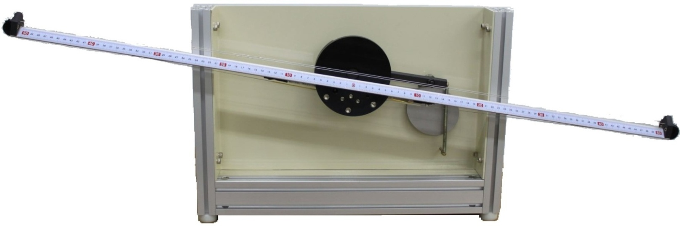
Ball and Beam System

Slide 2
Introduction
The ball on beam balancer system is one of the most enduringly popular and important laboratory models for teaching control systems engineering.
Control Mission: Automatically regulating the position of the ball on the beam by changing the angle of the beam.

Slide 3
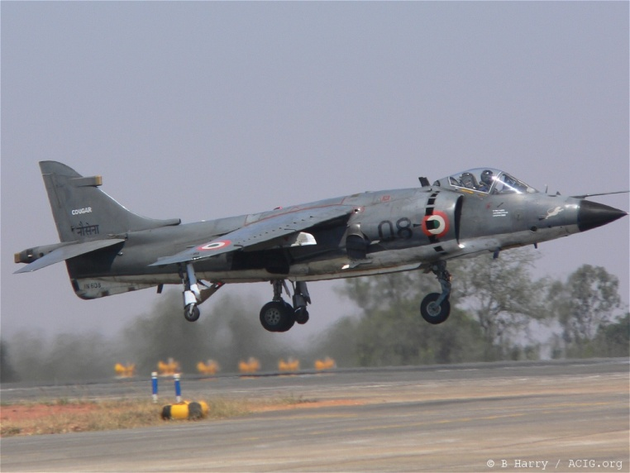
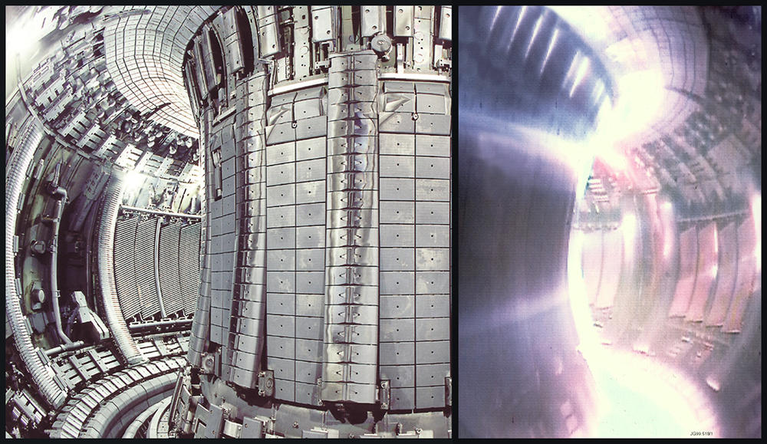
Practical Example of Unstable Systems
In chemical process industries: the control of exothermic chemical reactions.
In power generation: the position control of the plasma in the Joint European Torus (JET).
In aerospace: the control of the rocket or aircraft during vertical take-off.

Slide 4
The Experimental Topics
The behavior of unstable systems.
Measurement of system characteristics.
Stabilizations of an unstable system using PD control & PiD control action.
The use of cascade control.
Simple modeling and system re-drawn.

Slide 5
Ball and Beam Apparatus
The beam rotated through and angle of by an electrical motor attached to the beam via a profiled cam.
The beam angle is sensed by a servo potentiometer mounted at the rear of the beam shaft.
Two parallel wires are stretched along the top of the beam, one of the wires is connected to a voltage source, the other is used to a potentiometer to measured ball positions.

Slide 6
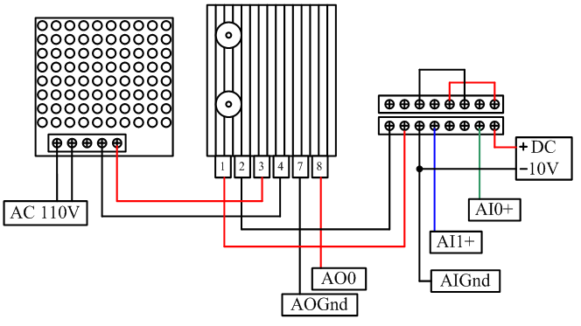
Connection
Connection between external power supplies for potentiometers. Figure illustrates the signal wires assembly.

Slide 7
Exercise I – Transducer Calibration
Record your results in Table 1.
Calculate the parameters of linear function which volts via ball positions.
Ball Position = a x Transducer Voltage + b
a = _________, b = _________
Ball Position(cm) | -30 | -10 | 0 | 10 | 30
Ball Position Transducer Output (volts)

Slide 8
Exercise I – Transducer Calibration
Record your results in Table 2.
Calculate the parameters of linear function which volts via beam angles.
Beam Angles = a x Transducer Voltage + b
a = _________, b = _________
Beam Angle (degrees) | -10 | 0
Beam Angle Transducer Output (volts)

Slide 9
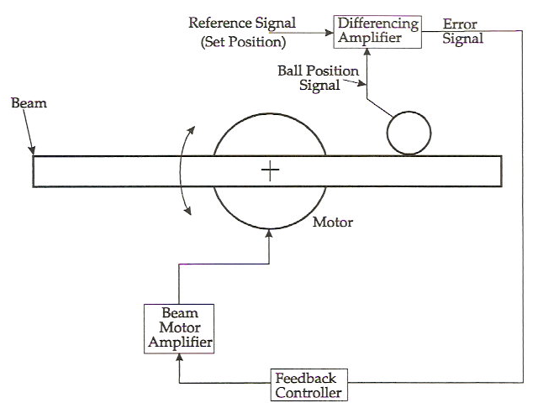
Control Principles
The closed-loop control system for the ball and beam which includes a feedback loop.

Slide 10
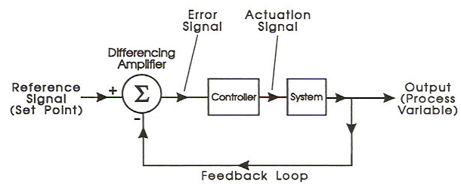
Control Principles
The schematic diagram

Slide 11
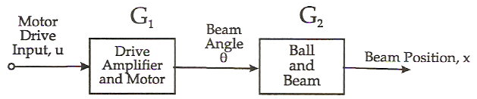
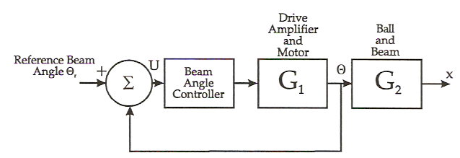
Control Principles
Control Strategy: Cascade Control

Slide 12
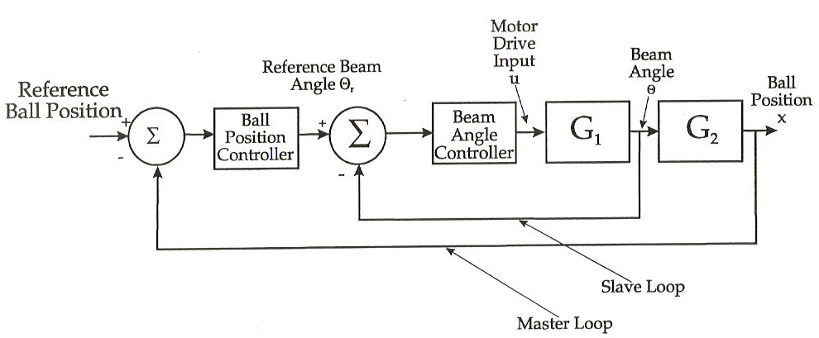
Control Principles
Control Strategy: Cascade Control

Slide 13
Control Principles
Beam Control
The following transfer function can be obtained for the motor and beam:

Slide 14
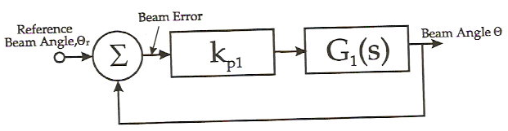
Control Principles
We using a proportional beam angle controller, then the closed-loop function is
If the proportional gain is high, so that .

Slide 15
Exercise II – Beam Angle Control
Record your results in Table 3.
Note that as the gain increases, the speed of response increases with overshoot.
Controller Gain ( ) | 1 | 3 | 5 | 7 | 15 | 20
Beam Angle Error (degree)

Slide 16
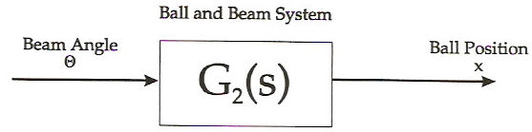
Control Principles
With a high gain proportional controller , the plane can be ignored and the control system re-drawn as

Slide 17
Control Principles
Simple Modeling
The dynamics of the ball rolling on the beam can be obtained by noting that the force which accelerates the ball as it rolls on the beam is that component of the gravitational force.

Slide 18
Control Principles
Simple Modeling
From Newton’s Laws: Force = Mass x Acceleration.
for small angles,
we can write down
Taking Laplace transforms, , where X is the ball position, is the beam angle.

Slide 19
Control Principles
Ball and Beam: Control
With a proportional plus derivative (PD) controller, can compensate for the unstable nature of the ball and beam.
The closed-loop system equation as

Slide 20
Control Principles
Ball and Beam: Control
Compare standard second order system equation,
where is the damping factor and is the natural frequency.
Compare coefficients of these equations that,

Slide 21
Exercise III – Ball and Beam Control
Calculation of the gain and record in Table 4.
Setting the gain and observing the response.
Damping Factor | Natural Frequency
1 | 3
0.707 | 1
0.707 | 3
0.5 | 1
0.5 | 3

Slide 22
Control Principles
Low Pass Filter Implementation
The low pass filter mentioned above may be easily implemented using an integrator with feedback round.
The system with low pass filter can reduce the influence by high frequency noise, and Figure shown the block diagram with filter.

Slide 23
Control Principles
The closed-loop system equation as
Thus the transfer function is stable with closed-loop poles given by
Compare this with the third order system equation, It can be seen by comparing coefficients of these equations that

Slide 24
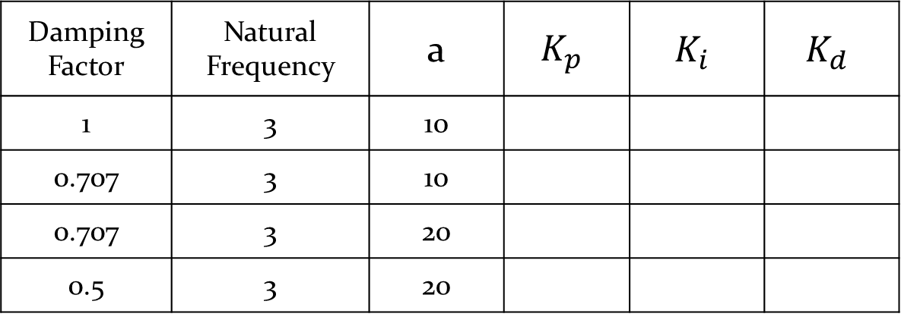
Exercise IV – Ball and Beam Control
Calculation of the gain and record in Table 5
Setting the gain and observing the response.
Damping Factor | Natural Frequency | a | $$K_{p}$$ | $$K_{i}$$ | $$K_{d}$$
1 | 3 | 10
0.707 | 3 | 10
0.707 | 3 | 20
0.5 | 3 | 20

